Slide 1
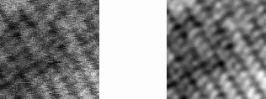
Deep convolutional neural networks to restore single-shot electron microscopy images
CNN
Workshop on machine learning methods in transmission electron microscopy
OCTOBER 28 - 29, 2024
Dr. Ivan Lobato

Slide 2
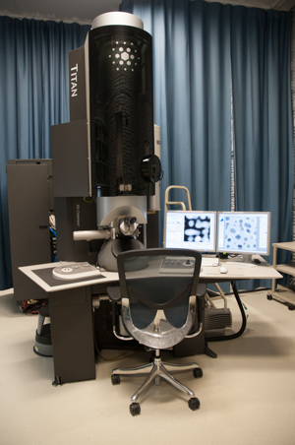
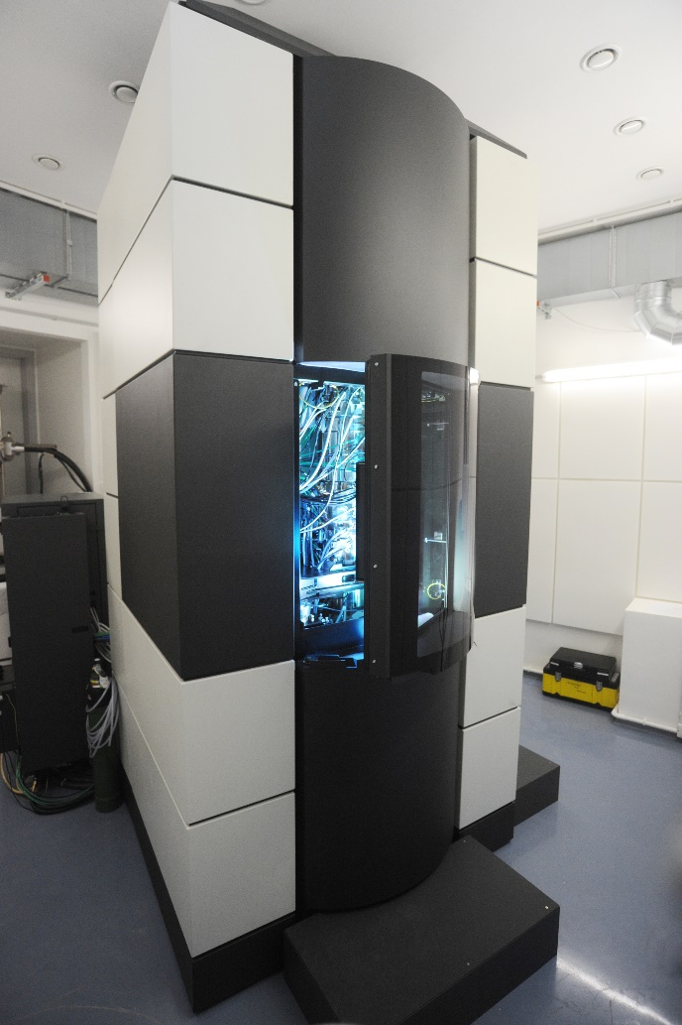
Electron microscope
Few millions of Euros

Slide 3
Outline
Introduction
Image distortions in STEM
Machine Learning
Architecture - Loss functions
Modelling distortions
Applications on real data
Conclusions

Slide 4
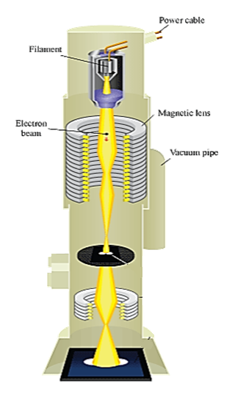
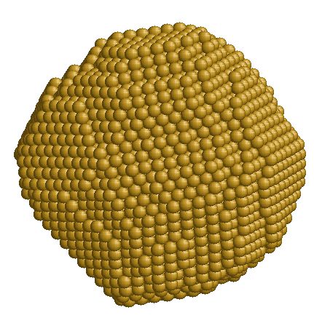
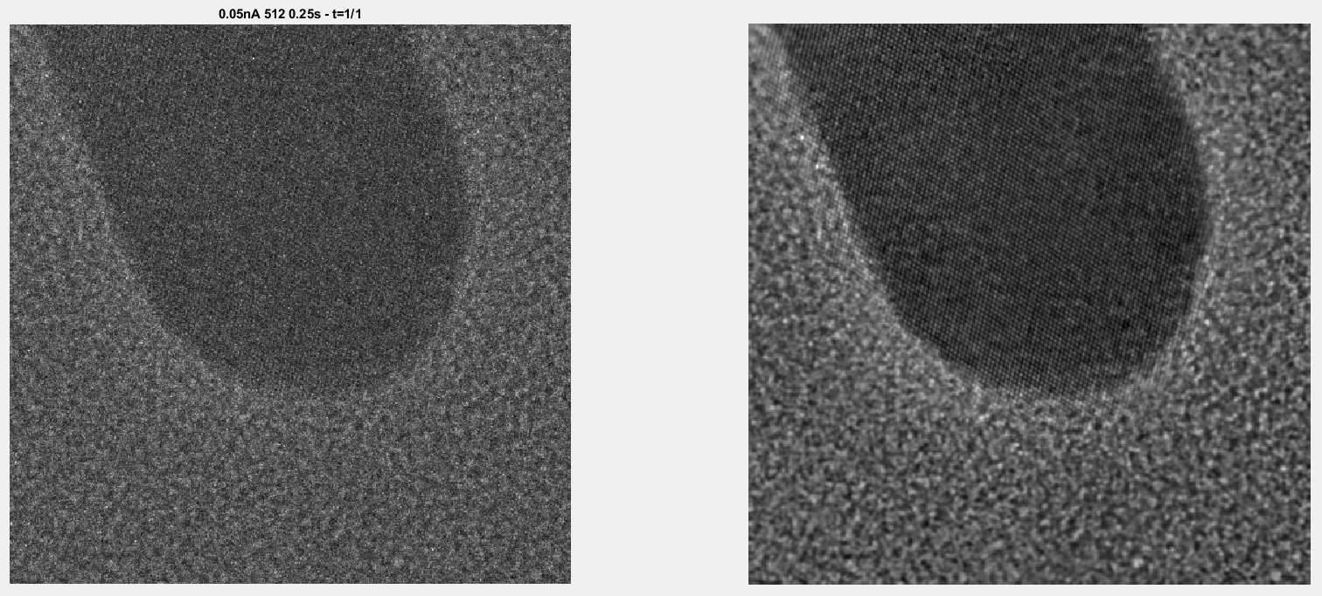
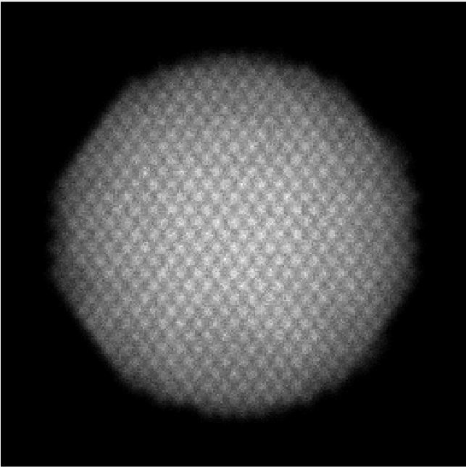
Parallel illumination data acquisition
TEM microscope
TEM

Slide 5

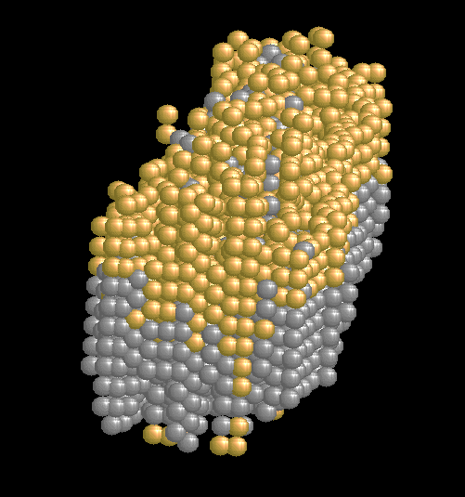
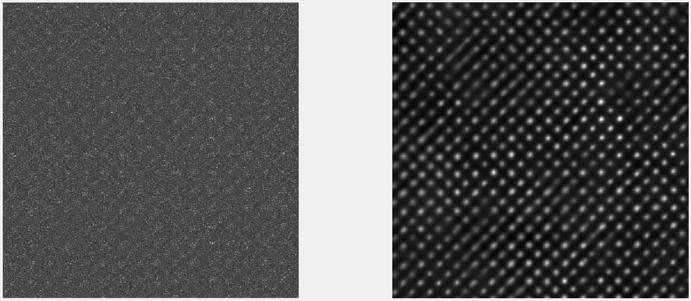
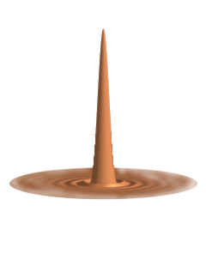
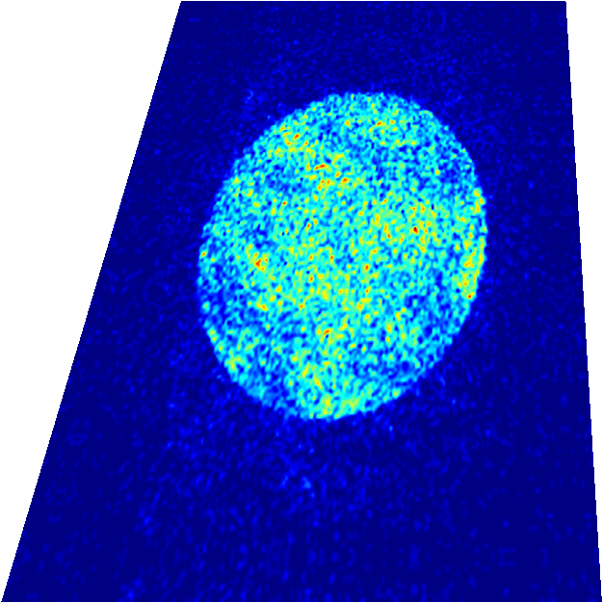

STEM acquisition
STEM microscope
STEM

Slide 6
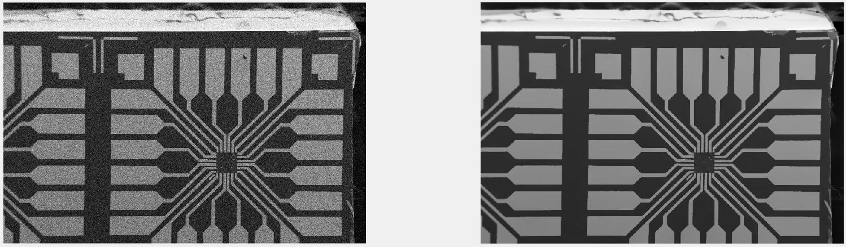
SEM acquisition
SEM microscope
SEM
Detector

Slide 7
Traditional Programming
Data
Computer
Output
Program
Machine Learning (supervised)
Data
Computer
Program
Output

Slide 8
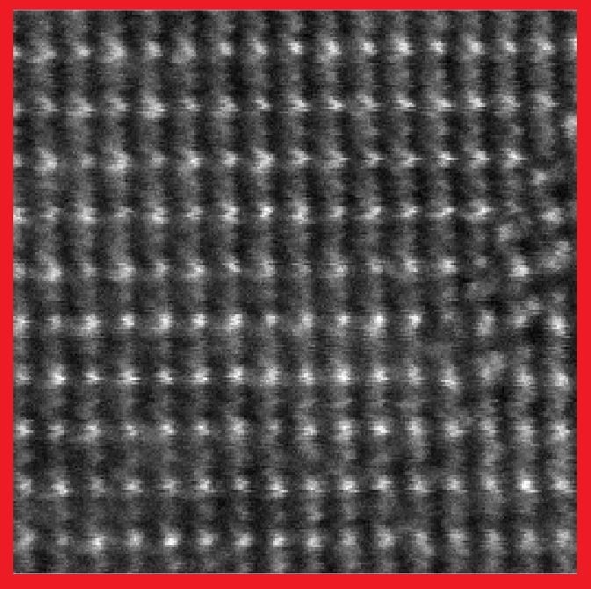
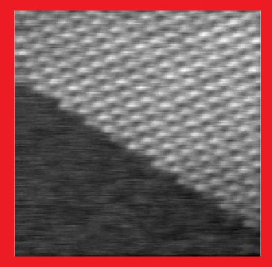
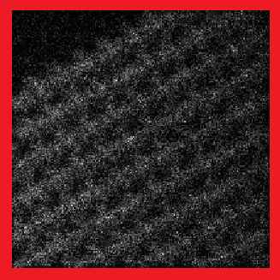
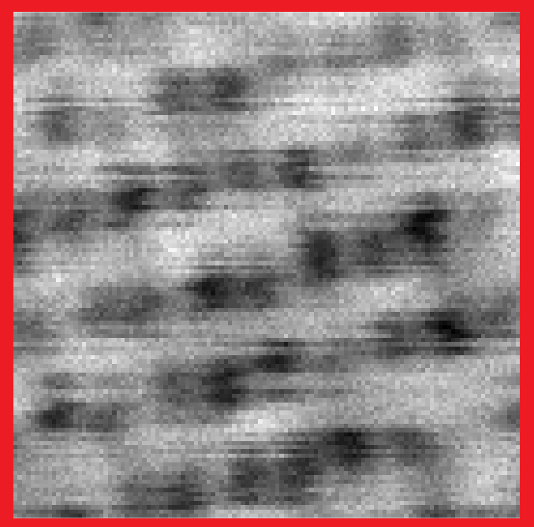
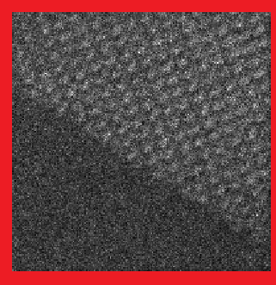
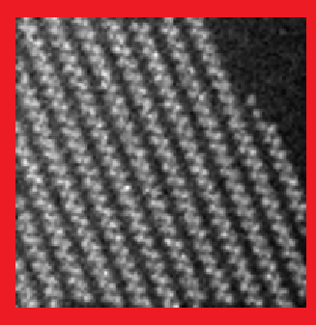
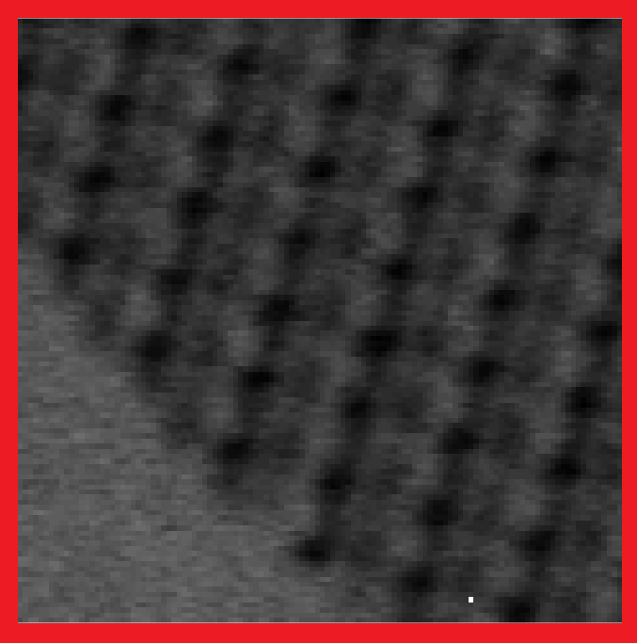
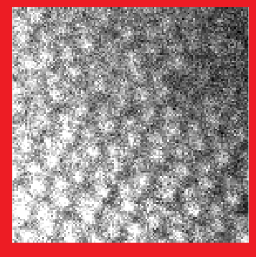
Some distortions in a single STEM micrograph
X Jitter
Fast scanning
Poisson noise
Y Jitter
Thermal noise
Downsampling
X ray
Saturation

Slide 9

Can all distortions in a single scanning transmission electron micrograph be corrected through automated post-processing?
Identification
Modelling
Localization
Quantification
No, if we use traditional programing..
Yes, if we use machine learning.

Slide 10
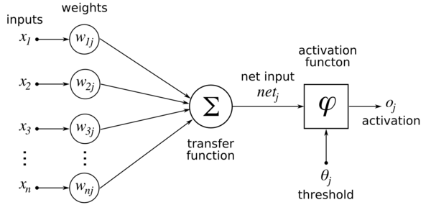

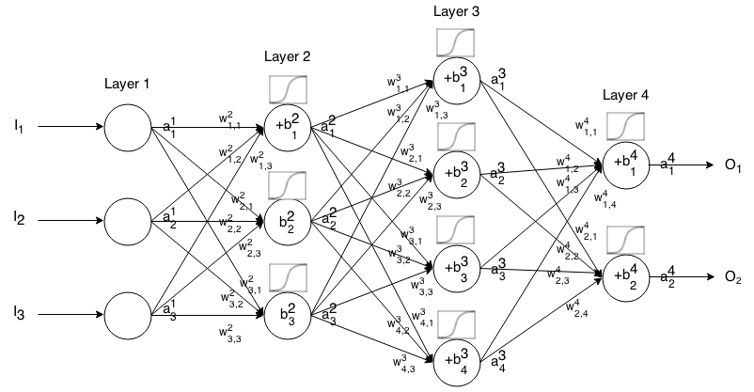
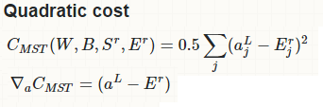
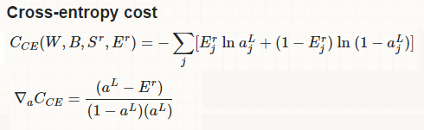
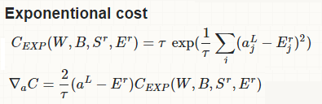
Hyperparameters
Artificial neuron
Neural networks

Slide 11
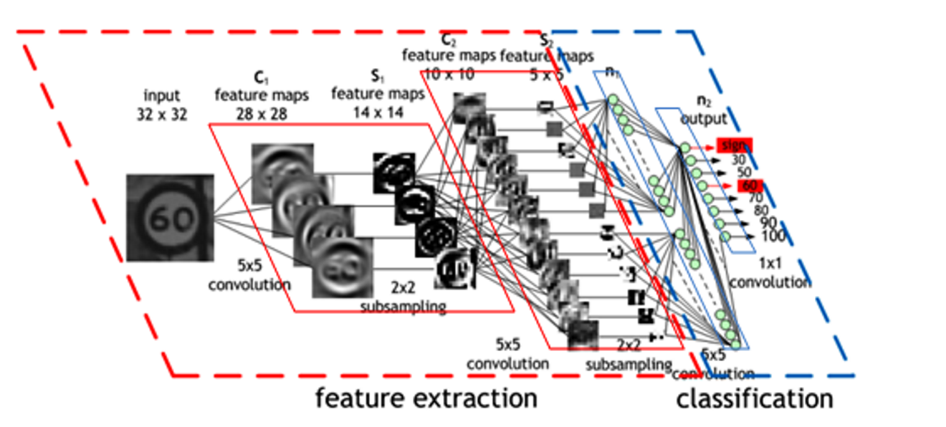
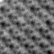
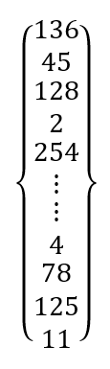
Convolutional neural networks
10^11
variables
512x512

Slide 12
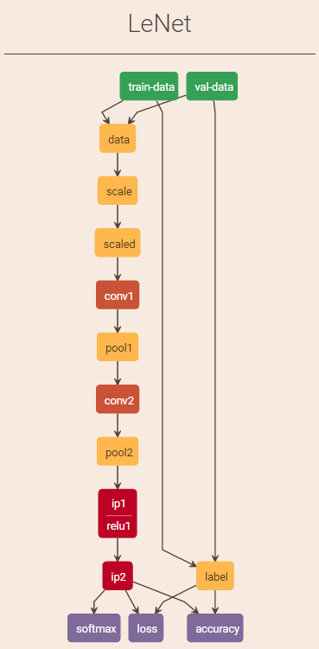
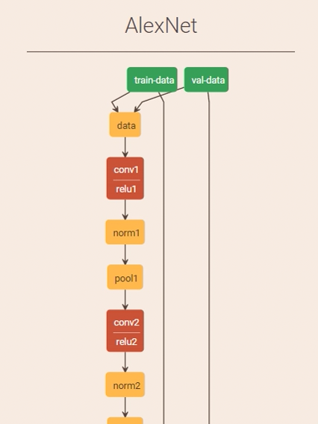
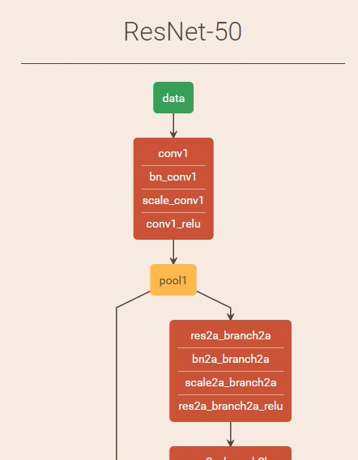
Neural network architectures
1998
2012
2015

Slide 13
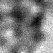

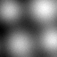

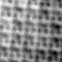
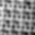
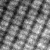
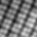
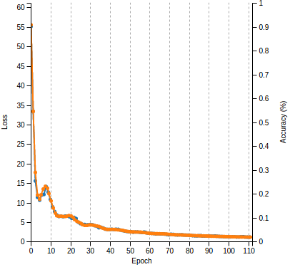
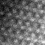

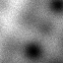

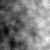
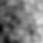
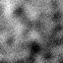
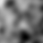
Training
Cost function
Validation

Slide 14
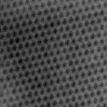
How to obtain undistorted STEM images?
We are only able to collect distorted data.
The experimental data is limited to few samples SrTiO₃[001], Au[110], etc.).
Therefore, we have to use synthetic data: simulated STEM images for different specimens, orientations, misalignments, aberrations, amorphous layers, microscope parameters, etc.

Slide 15
Workflow for training a neural network
Distorted data
Architecture
Loss functions
Training procedure
undistorted data
How to get realistic pair of distorted/undistorted data
Simulated distorted data
Simulated undistorted data

Slide 16

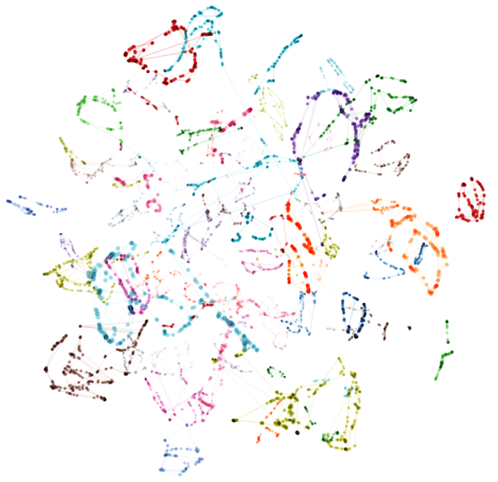
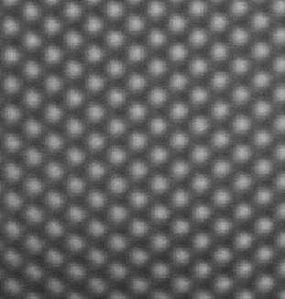
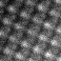
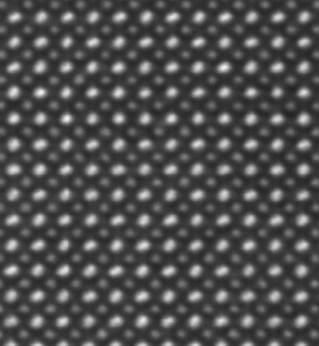
Importance of sampling
Phase space of all possible STEM images
Au[110]
SrTiO₃[001]

Slide 17
Architectures

Slide 18
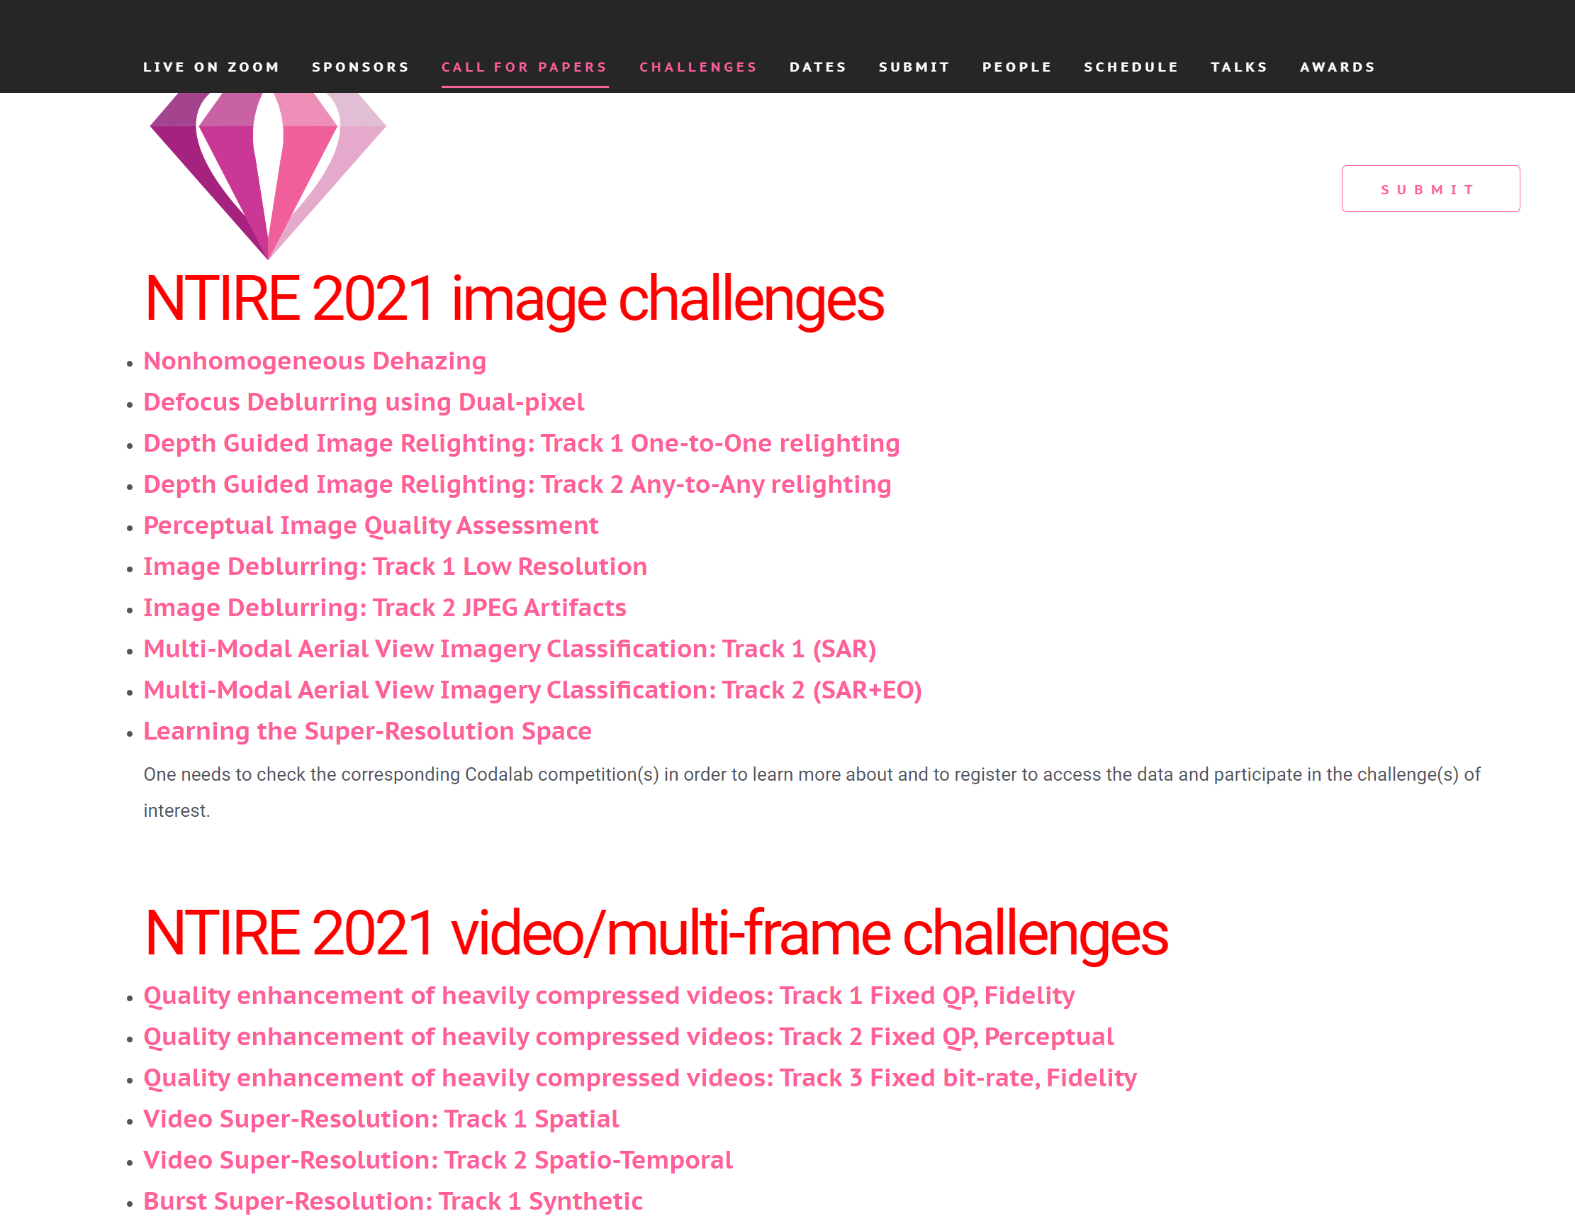

Architecture

Slide 19

Generator architecture

Slide 20


Discriminator architecture

Slide 21
Loss functions

Slide 22






Loss function

Slide 23

Multi-local whitening transform

Slide 24
Data generation

Slide 25

Undistorted data generation

Slide 26



Undistorted data generation

Slide 27
Distorted data generation

Slide 28

Some distortions in a single STEM micrograph

Slide 29




X-Jitter

Slide 30



Y-Jitter

Slide 31



XY-Jitter

Slide 32











Detector noise
Ground Truth
F=1
F=5
F=25

Slide 33


Fast scanning distortions

Slide 34






Fast scanning distortions
Ground truth
alpha = 0.12
alpha = 0.35
alpha = 0.85

Slide 35





Saturation distortion
Ground Truth
Poisson noise
Saturation

Slide 36








Upsampling distortion
Ground Truth
F=1
F=2
F=4

Slide 37





Downsampling distortion
Ground Truth
F=1
F=0.5
F=0.25

Slide 38

Some distortions in a single TEM micrograph

Slide 39


Available networks
HR
sfr_hrstem (single frame high resolution TEM)
sfr_lrstem (single frame low resolution TEM)
sfr_hrtem (single frame high resolution STEM)
sfr_lrtem (single frame low resolution STEM)
sfr_hrsem (single frame high resolution SEM)
sfr_lrsem (single frame low resolution SEM)
LR

Slide 40
Comparison of neural network performance on simulated data

Slide 41

High resolution STEM

Slide 42

High resolution TEM

Slide 43

High resolution STEM

Slide 44

Comparison of the CNN restoration to the BM3D algorithm

Slide 45

Selecting the optimal neural network for your data

Slide 46
Comparison of neural network performance on experimental data

Slide 47
Results HRSTEM

Slide 48
SrTio3

Slide 49

Pt nanoparticle-Gas Holder

Slide 50

Ag nanoparticle

Slide 51

Ag nanoparticle

Slide 52
Results HRTEM

Slide 53
Nanorod
A)
B)

Slide 54


Slide 55
Results SEM

Slide 56


Slide 57

A)
B)

Slide 58
A)
B)

Slide 59


Slide 60


Slide 61

Comparing CNN restoration methods on HAADF-STEM data

Slide 62

Precision comparison in estimating unknown structure parameters with and without CNN

Slide 63

Application of the CNN restoration to an imperfect crystal structure

Slide 64

Performance of the CNN restoration for atom counting

Slide 65

Evaluating neural network performance on white noise data

Slide 66

Evaluating neural network performance on counting noise data

Slide 67

Evaluating neural network performance on counting noise in tilted samples

Slide 68
Do the restored EM images enhance resolution compared to the raw data?

Slide 69



Slide 70
Can the restored EM images aid in segmentation?

Slide 71


Slide 72
Can restored EM images improve the physical modeling of the detection process?

Slide 73


Slide 74





Y-scan distortion
Raw data
CCN (1)
Raw data
CCN (1)
CCN (2)
Range of the y-scan distortion

Slide 75





High-speed scans
Raw data
CCN (1)
Raw data
CCN (1)
CCN (2)
Modelling of the high-speed scans

Slide 76
Modelling improvement using experimental data
Experimental Data
NN
Is distortion free?
No
Retrain
Improve modelling

Slide 77
New improvements
Adversarial training for robustness
Time series analysis for temporal dynamics
Enhanced specimen diversity using stable diffusion
New network architecture competing with vision transformers and diffusion models
Multi-size training for scalability
Inclusion of direct electron detector distortion
Single network for all EM

Slide 78

Thank you
See you at hands-on session
https://github.com/Ivanlh20/tk_r_em/tree/master/workshop_29_10_2024

